Slide 1
CAMPUS NETWORK DESIGN
NET1014 Networking Principles
Group 20

Slide 2
GROUP MEMBERS
LIM XIWEI
21045596
LAI LI XUAN
22089148
THAM ROU YI
THAM JIAN HAO
21024161
21042692
NG JIA WEN
21057146

Slide 3
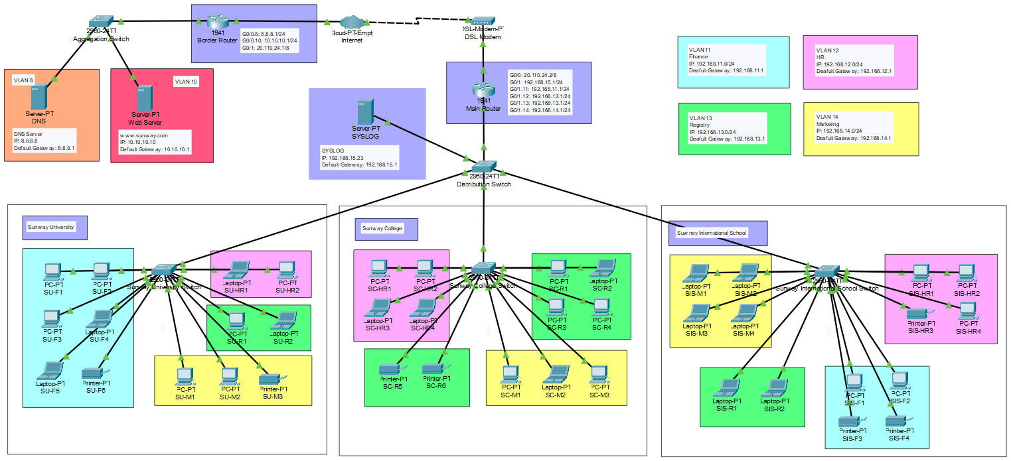
OVERVIEW
Notes:
Can use packet tracer to show this
This is the overview of our campus network design. Our network encompass 3 different buildings such as SC, SU, SIS.
In each of these building exists 4 different VLANs labeled in different colors such as Finance, HR, Marketing and Registry.
The reason why we use VLANs is to isolate network traffic, and categorize devices into their distinct virtual networks based on their department or purpose.

Slide 4
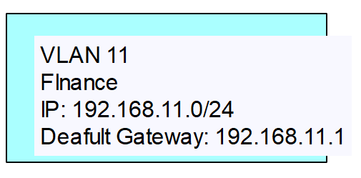
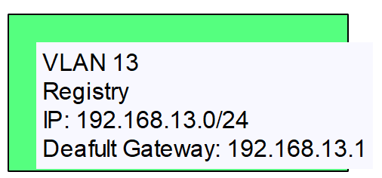
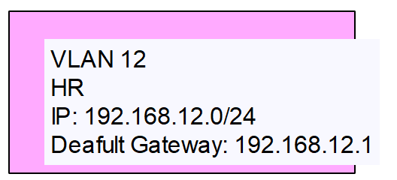
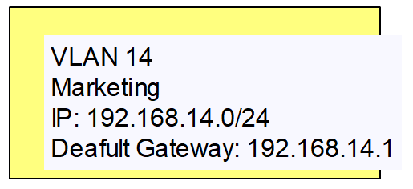
VLANs ACROSS 3 BUILDINGS
FINANCE
REGISTRY
SUNWAY COLLEGE
SUNWAY UNIVERSITY
SUNWAY INTERNATIONAL SCHOOL
HR
MARKETING
Notes:
*think no need this*
If we take a closer look, the VLANs, IP address and default gateways of all departments are configured accordingly.

Slide 5

ROUTER-ON-A-STICK
WHAT?
PROS
Inter VLAN Routing
Cost Efficiency
WARNING!
WHY?
PROS
Heavy Reliance on Main Router
Single Interface to Route Between Subnets
Scalability & Versatility
Notes:
The core of our design is actually an inter VLAN routing technique, known as router on a stick.
This technique allows VLANs to communicate using a single physical interface on the main router.
Whereas the sub-interfaces corresponding to each VLANs are configured on the main router's interface through dynamic routing.
However, we do acknowledge a major drawback in this method, where it is very dependent on the main router. In a sense where if the main router experience failure or becomes unavailable, the entire network connectivity will be disrupted.
This is because the main router is to route the packets between networks and also the external network will be impacted.
Nevertheless, we still chose to go with this design considering the factors of cost efficiency and scalability if the campus decided to add more buildings or offices, where we can just configure at the main router, and modify or add more VLANs.

Slide 6
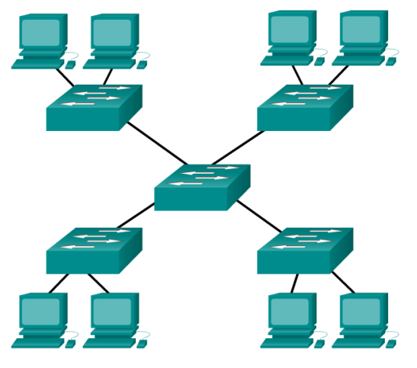
EXTENDED STAR TOPOLOGY
Star topology with additional networking devices connected to the central device
Better Performance
&
Easier Maintenance
Notes:
Our design is actually a representation of an extended star topology.
Where the central switch of each of the star topology is connected to the main switch and this main switch will be connected to our main router.
(for qna only)
Better performance : compared to bus topology, because there is no unnecessary transmission of a message in the network. The message is transferred only between the source node, a central hub, and the destination node.
Easier Maintenance or trouble shooting: Each host is connected to the central device with its own wire. If there is a problem with that cable, only that host is affected. The rest of the network remains operational.

Slide 7
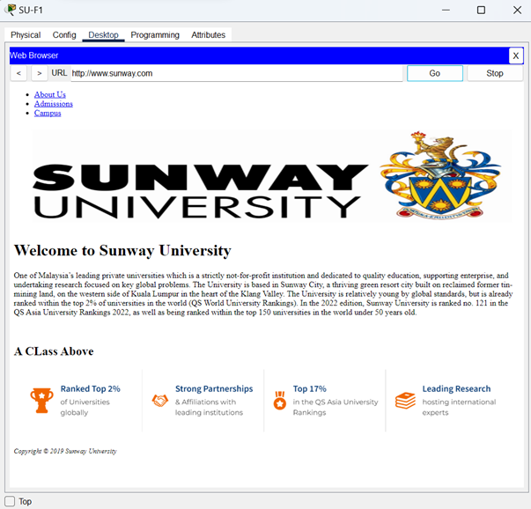
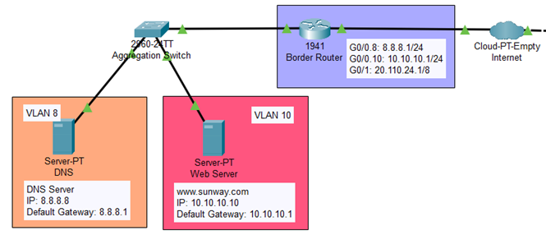
NETWORK ACCESS
WEB BROWSING
Browse Website Hosted on Web Server
EXTERNAL NETWORK INFRASTRUCTURE
Border Router routing to external network
Web Server
DNS Server
Notes:
*this slide also no need*
Next, I will move on to the first feature of our design which is accessing the external network.
(move to cisco)
The infrastructure to implement a network access is like this, where our main router is connected to a cloud-based service that symbolizes the internet, through a DSL line. Then packets will be routed by the border router which connects to the external network.
(demo)

Slide 8
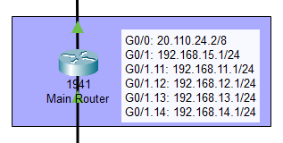
NETWORK ISOLATION
Private Network
Public Network
Improved security
Increased performance
Enhanced privacy
Direct Internet Accessibility
Notes:
The second feature of our campus network is network isolation. This is can be achieved by creating VLANs using private IP addresses within our network. This approach is beneficial as we can hide internal devices from the internet, preventing it from being hacked and thus improving security. Also, since the traffic only stays within the local network, it can also increase performance and enhance privacy. The network connecting to the ISP would then become the public network. This provides the internal network with direct internet accessibility.

Slide 9
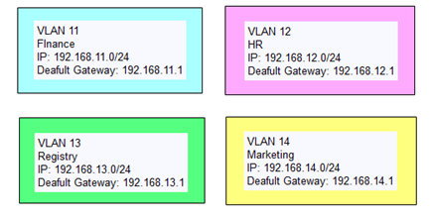
CLASSLESS IP ADDRESSING
Efficient Address Allocation
Improved Internet Growth and Scalability
Notes:
Another feature of our network is the use of classless IP addressing. This is implemented in the network address of our VLANs. By having this, we can maximize the efficient use of IP addresses, so that there won’t be any address space being wasted. Another thing is that This approach allows for optimized address allocation within each department and at the same time accommodating for future growth and scalability requirements as more and more devices go online in the future.
Next, I will demo the intervlan connectivity along with their ping results.
I will be testing out 4 scenarios and will be using this PC as the reference point
The first test is same vlan, same department
The second test is same vlan, different department
The third test is different vlan, same department
The fourth test is different vlan, different department

Slide 10
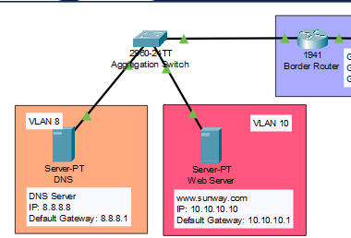
Switch
Aggregation Switch
Collecting and consolidating data traffic from multiple sources, such as servers, and then directing that traffic to the appropriate destinations.
It acts as a central point of connection for various devices and serves to optimize the flow of data within the network.

Slide 11
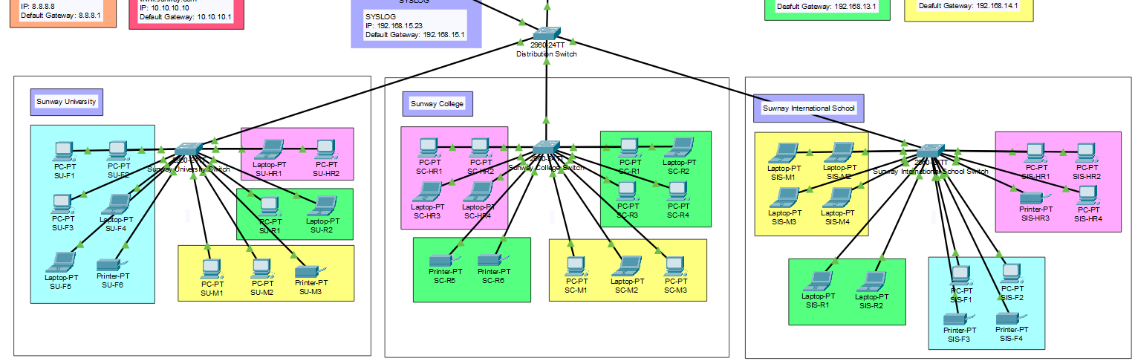
Switch
Distribution Switch
Aggregating and distributing network traffic from various access switches within the respective buildings.
University, College and International School switches are transmission of data between devices within the University, College and International School .

Slide 12
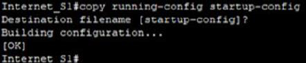
Set Up Access Port
“switchport mode access”
Auto-start & Configuration Saving
Switch deployment across multiple locations and departments is made efficient by using auto-start and configuration saving features.

Slide 13
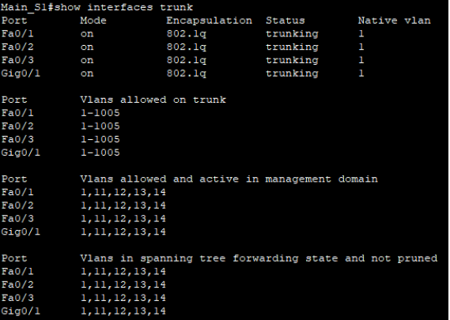
Trunking and Encapsulation
•Trunking allows transmission of multiple VLANs over a single connection, ensuring scalability and simplified network management.
•Configuration of trunking is done using the "switchport mode trunk" command.
•The command "show interface trunk" also displays the VLANs authorized on the trunk, with VLANs 1 to 1005 typically allowed to communicate across the trunk.

Slide 14
Router
Border Router
Main Router
Enables communication
Acts as internal gateway
Notes:
We have included 2 routers in our campus network design, which are the border router and the main router.
Border router link DNS server and web server and it enables the communication between internal network and external server.
While the main router link DSL modem and all workstations, and it also act as an internal gateway for internal network.

Slide 15
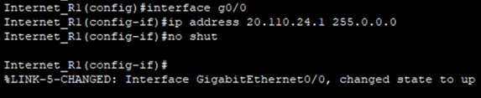
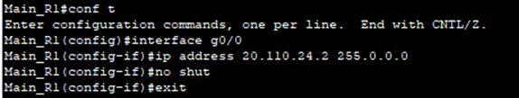
Setting Up Default Gateway
Allows data transmission
Improves overall network performance
Notes:
Default gateway is set at both the border router and main router.
This is the screenshot of us setting up default gateway at the border router.
Setting up default gateway at border router enables the communication between the internal campus network and the external network such as the Internet.
The internet traffic is first filtered before reaching the central campus network, which provides isolation between the internal network and external network for security purpose.
It can also help in offloading internet-bound traffic, as well as improving overall network performance.

Slide 16
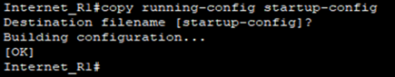
Auto-start & Configuration Saving
Save the running configuration to the startup file
The routers would maintain their configuration settings even after a restart or power cut.
Notes:
Then to make our routers start automatically after rebooting, we used the copy running-config startup-config command to save the running configuration to the startup file on the non-volatile random-access memory (NVRAM) after finishing all configurations.
After this procedure, the routers would maintain their configuration settings even after a restart or power cut.

Slide 17
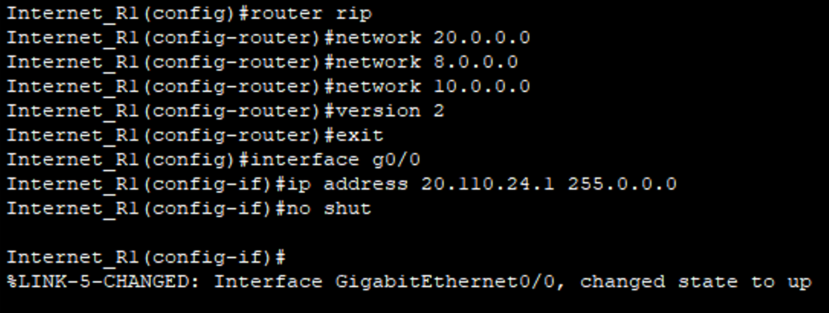
Dynamic Routing
Help to handle large and complex network efficiently
Adapt to changes in network topology automatically, routing tables adjusted accordingly
RIP routers choose the most optimal path for data transmission
Notes:
Last but not least, we have also implemented dynamic routing to both the routers by enabling routing information protocol (RIP) in the network.
This is the screenshot showing the process of implementing dynamic routing to the border router.
Dynamic routing helps to handle large and complex network efficiently.
RIP router adapt to changes in the network topology automatically.
If there are network changes, RIP router exchange routing information and update the routing table accordingly.
By continuously exchanging routing information, RIP routers can calculate the best and shortest path and eventually choose the most optimal path for data transmission.

Slide 18

WARNING!
Oh no! Our newly designed network is under attack by sneaky cyber-critters! But fear not, fellow tech warriors, we shall rise to the occasion and defend our kingdom of data with some super cool security measures!

Slide 19


Security Mechanism
Essential because...
Intrusion Prevention System (IPS)
Enables monitoring of malicious activities, ensuring swift detection and response to potential threats
Enforces access control policies, securing the network from unauthorized access and policy violations
Implementation of Firewall on PCs

Slide 20
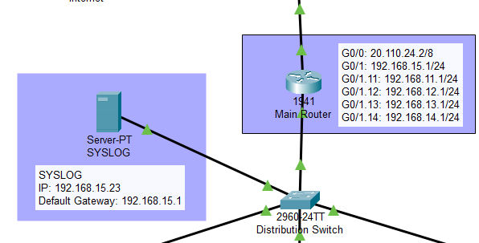


Intrusion Prevention System (IPS)
Monitors network and/or system activities for malicious behavior and policy violations in real-time
Takes proactive measures to block and stop suspicious or unauthorized activities
Best practice: Add a syslog server to centralize IPS log management
Where IPS rule apply
Syslog server

Slide 21
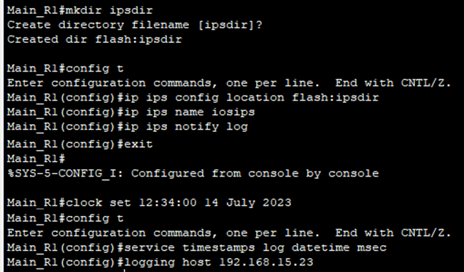
IPS Configuration Commands
Enable Security Technology Package
license boot module c1900 technology-package securityk9
Configure the IPS Signature Storage Location
ip ips config location flash:ipsdir
Create an IPS Rule
ip ips name iosips
Enable Logging
ip ips notify log
Enable Timestamp Service
service timestamps log datetime msec
Configure Syslog Server's IP Address
logging host 192.168.15.23

Slide 22
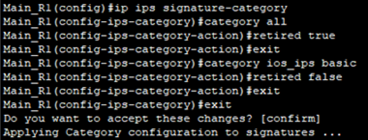
Retire All Signature Category Except “IOS_IPS Basic” Category
ip ips signature-category
category all
retired true
exit
category ios_ips basic
retired false
What is Signature Category?
A signature in IPS is a set of rules that detects intrusive activity, and these signatures are grouped into categories based on attack patterns. IPS uses these categories to identify and block potential threats on the network.

Slide 23
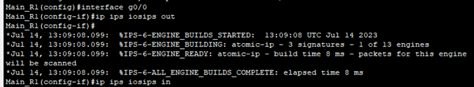
Applying IPS Rule to G0/0 Interface
interface g0/0
ip ips iosips out
ip ips iosips in
What is “in” and “out”?
"In" direction: IPS inspects traffic entering the interface.
"Out" direction: IPS inspects traffic exiting the interface.

Slide 24
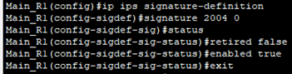
Un-retire the Echo Request Signature
Echo Request Signature
ip ips signature-definition
signature 2004 0
status
retired false
enabled true
The Echo Request signature has ID 2004, and Subsignature ID 0 which means the default rule without specific variation is used.
The signature is designed to detect incoming ICMP Echo Request packets.

Slide 25

Event Action
produce-alert
Generate an alert notification when the signature detects matching network traffic
deny-packet-inline
Enabling the device to block or deny the offending packet in real-time
Change the Event-action of a Signature
engine
event-action produce-alert
event-action deny-packet-inline

Slide 26
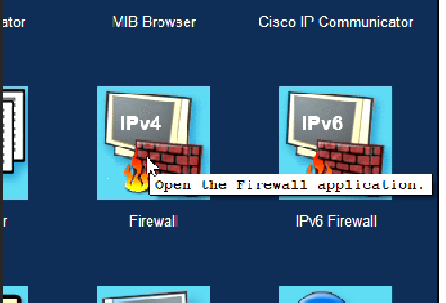
Firewall on PCs
Why Firewall?
Works together with the IPS to provide a multi-layered security approach
Offers host-level protection by controlling traffic for the device, restricting access to services, and defending against targeted attacks.

Slide 27
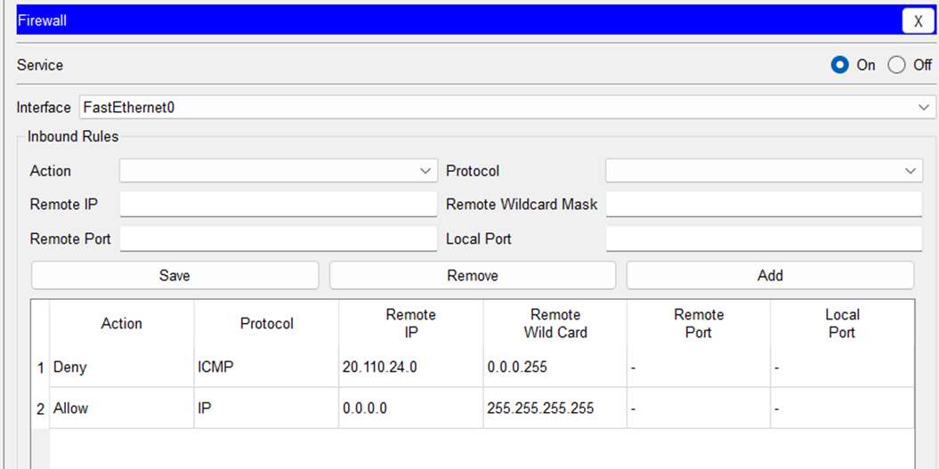
Firewall Configuration
First Rule:
blocks ICMP traffic from the IP addresses within public network (20.110.24.0 - 20.110.24.255)
prevents external sources within the specified IP range from initiating ICMP requests towards our network

Slide 28
“Specific Before Generic” Principle
Second Rule:
Allows all outgoing IP traffic
To enable communication between the workstations within the private network
Firewall rules are evaluated in order from top to bottom
When a rule matches the incoming traffic, further rule evaluation stops
Placing specific rules first ensures they take precedence over more general rules

Slide 29
THANK YOU!

Slide 30
Instructions for use
In order to use this template, you must credit Slidesgo in your final presentation.
You are allowed to:
- Modify this template.
- Use it for both personal and commercial projects.
You are not allowed to:
- Sublicense, sell or rent any of Slidesgo Content (or a modified version of Slidesgo Content).
- Distribute Slidesgo Content unless it has been expressly authorized by Slidesgo.
- Include Slidesgo Content in an online or offline database or file.
- Offer Slidesgo templates (or modified versions of Slidesgo templates) for download.
- Acquire the copyright of Slidesgo Content.
For more information about editing slides, please read our FAQs or visit Slidesgo School:
https://slidesgo.com/faqs and https://slidesgo.com/slidesgo-school

